Slide 1

Intelligent White Cane
AIoT Group8
Notes:
As the video showed, today I will demonstrate the AIoT-based Intelligent White Cane we designed.

Slide 2
Content
01
Overview of problem statement
02
Overview of solution statement
03
Details on IoT prototype
04
Details on machine learning models
05
Details on software applications
Notes:
The content will include 5 parts. From the raise of the problem to its solution, I will guide you through each step.

Slide 3
Overview of problem statement
01
Notes:
First, let's look at the overview of the problem statement.

Slide 4
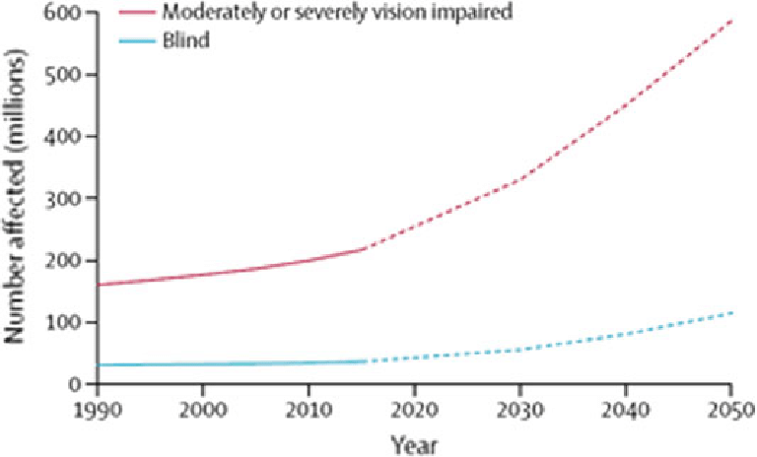
Problem Statement
Current market-available canes fail to meet the various needs of users.
Significant
The number of visually impaired individuals is increasing steadily.
to conduct
intelligent white cane
Notes:
Why do we want to design an intelligent white cane? Because it will meet the market need. As you can see in this chart, the number of visually impaired individuals is increasing steadily. Current market-available canes fail to meet the various needs of users, and didn’t keep up with the current trend of AIoT. This is why it’s significant to conduct intelligent white cane.

Slide 5
Overview of Solution statement
02
Notes:
To solve this problem, we designed the solution system as follows.

Slide 6
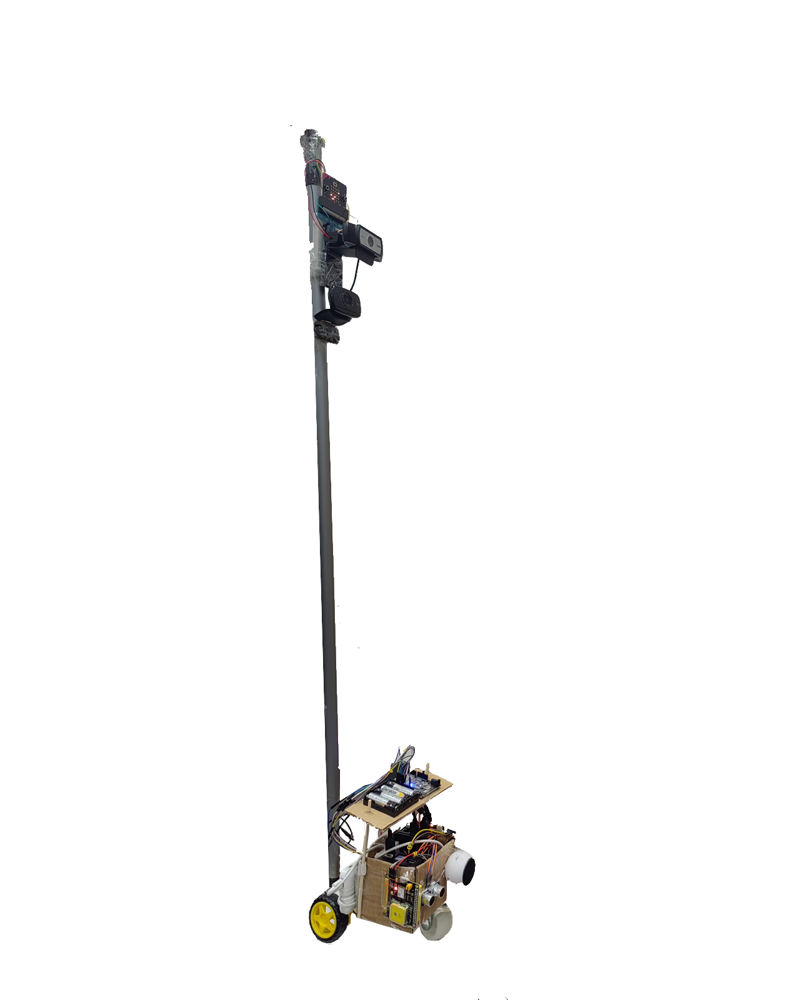
Solution Statement
Fall Detection
Sending an email alert to caregivers.
GPS Real-time Location
Tracks the user's path and navigate automatically.
Traffic Lights and Crosswalk Recognition
Ensures the safety of visually impaired individuals when crossing the street.
Environmental Detection
Detects weather and alerts when changes occur.
Notes:
This cane system integrates features such as fall detection, GPS real-time location, traffic lights and crosswalk recognition, environmental detection,

Slide 7
Solution Statement
Obstacle Avoidance
Uses ultrasonic sensors and a camera to detect and avoid obstacles.
Intelligent Voice Assistant
Inquire about the needs of visually impaired individuals,Including taking a taxi, asking for weather and time and so on.
Webpage Interface
Provides caregivers with the ability to monitor the condition of the visually impaired individual.
Notes:
and obstacle avoidance to act as the user's eyes and ensure their safety. Meanwhile, an intelligent voice assistant and a webpage interface are applied to ensure the easy use for the user and allow family members to monitor remotely.

Slide 8
Details on IoT prototype
03
Notes:
Now, let's look at our details on the IoT prototype.

Slide 9
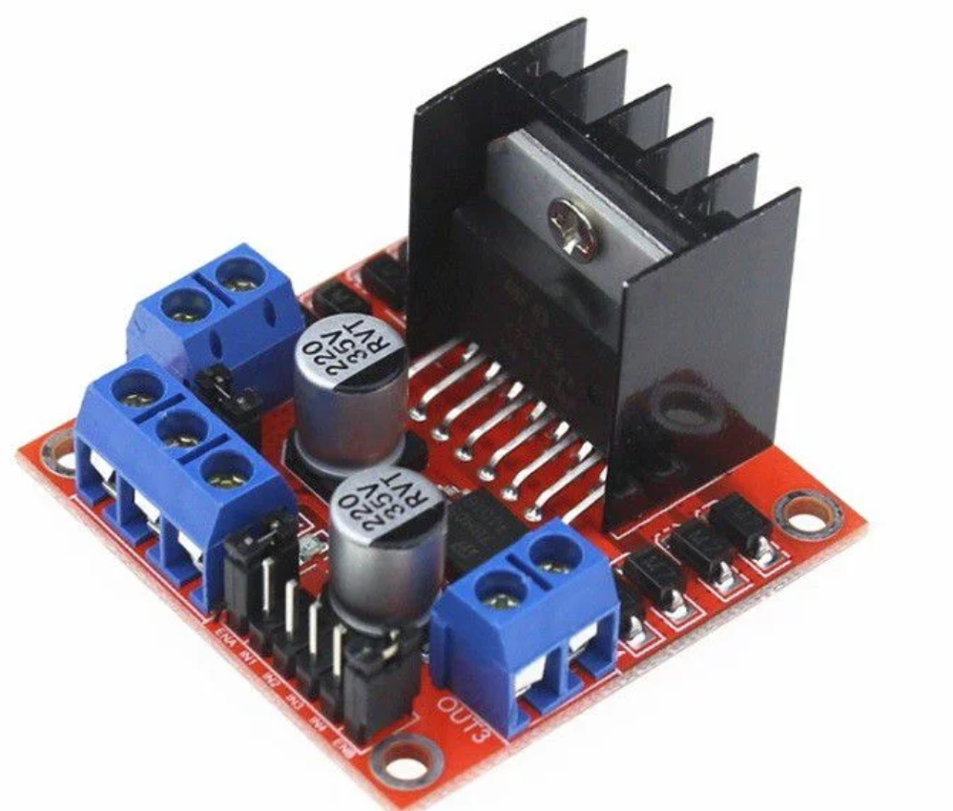
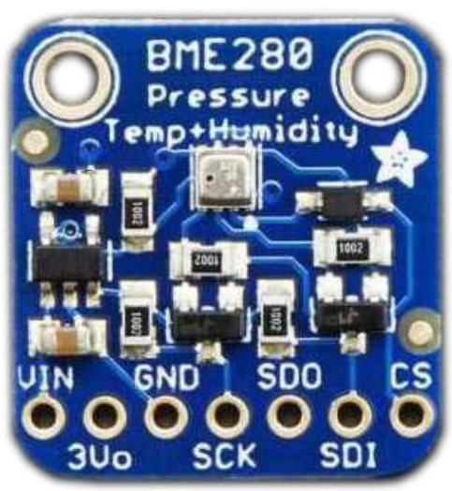
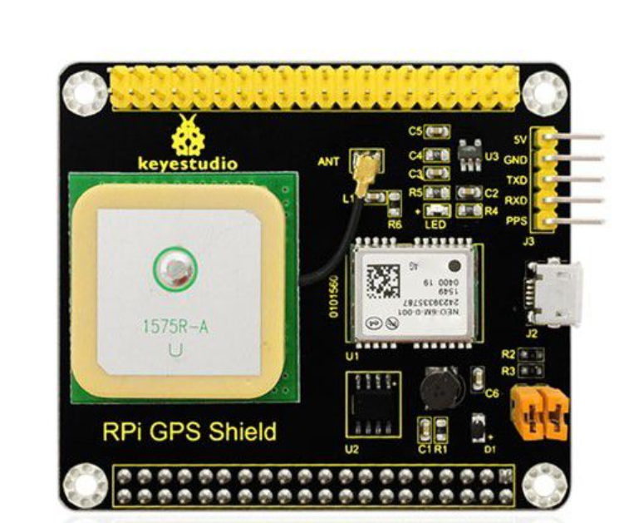
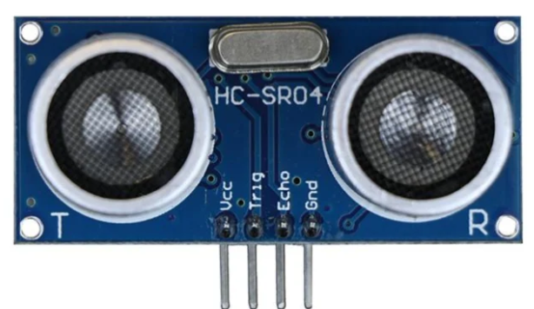
L298N motor driver
Weather Detection
Motor Driver
(H Bridge)
HArdware
overview
(sensors)
NEOM6-GPS
Ultrasonic Distance Sensor
Bosch BME280 Environmental Sensor
Other devices:
Camera,
Motor,
Speaker...
Navigation & Location
Obstacle Detection
Notes:
These are the sensors we use, like the NEOM6 for GPS location, the BME280 for weather detection, and others for obstacle detection, motor driving, etc.

Slide 10
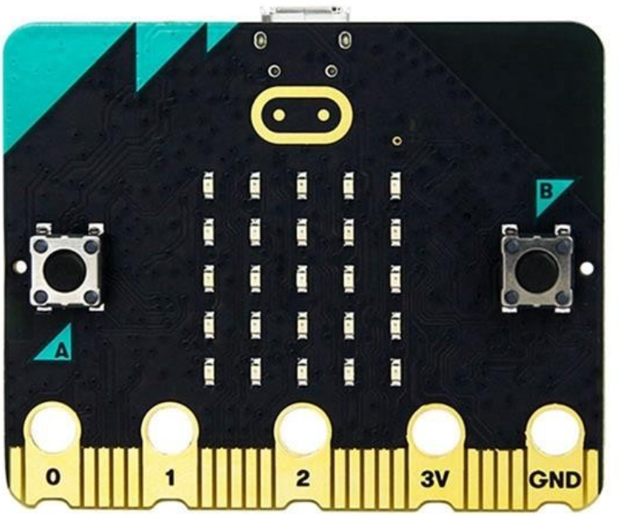
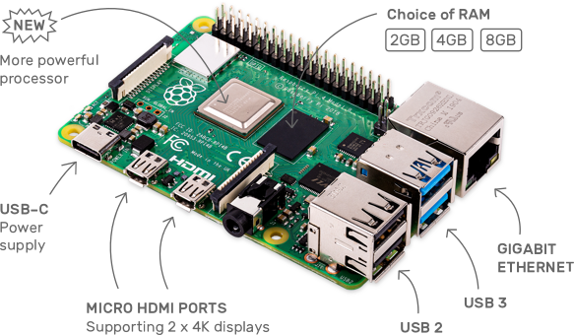
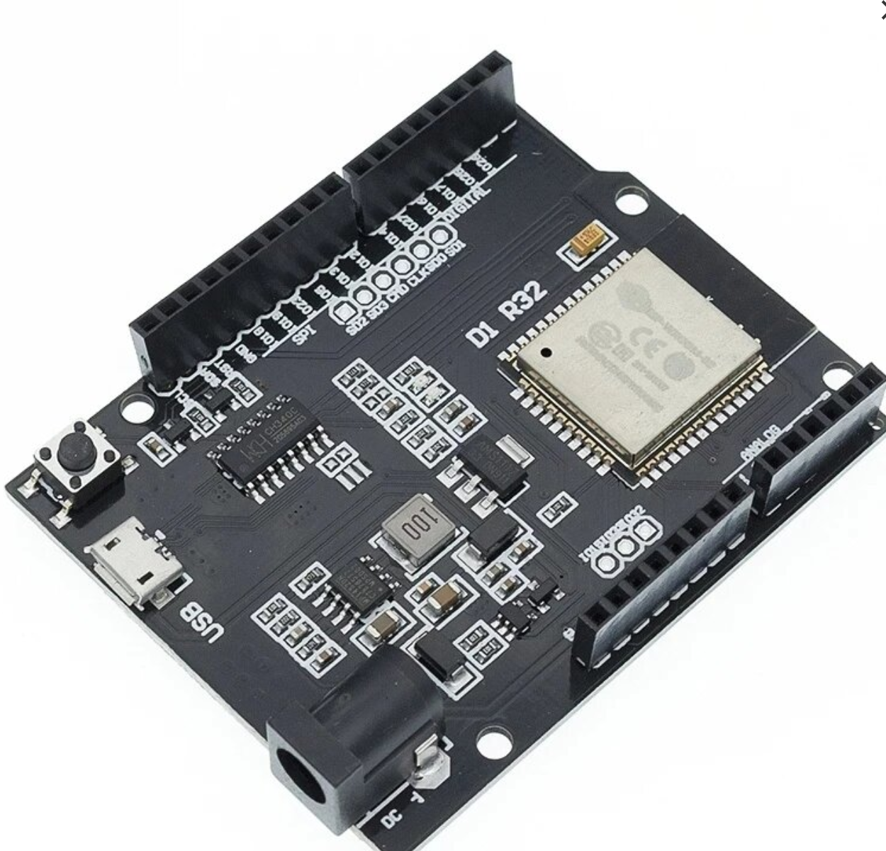
Fall Detection
HArdware
overview
(demo boards)
Raspberry Pi 4B
ESP32
Micro:bit
Automatic Traction
Core part of hardware devices...
Notes:
The ESP32 is used to drive the motor for automatic traction, and the micro:bit is used for fall detection and other data transmissions. The Raspberry Pi acts as a fog server, which is the core part of our hardware devices.

Slide 11
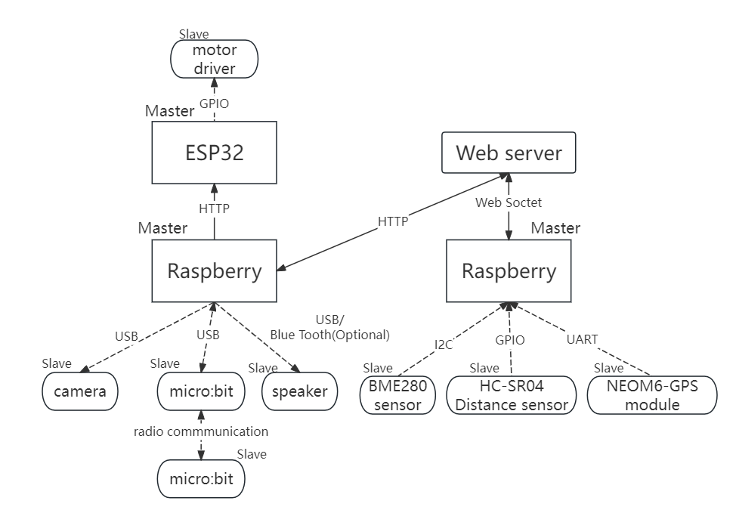
IOT
architecture
We adopts the
Master-Slave mode as the overall architecture.
Notes:
As you can see in the overall IoT architecture, we adopt the Master-Slave mode. For edge sensors to connect to the hub or fog server, we use protocols and transmission methods like radio communication, USB, Bluetooth, I2C, GPIO, and UART. For communication between the fog server and the cloud server, we primarily use HTTP and WebSocket protocols.

Slide 12
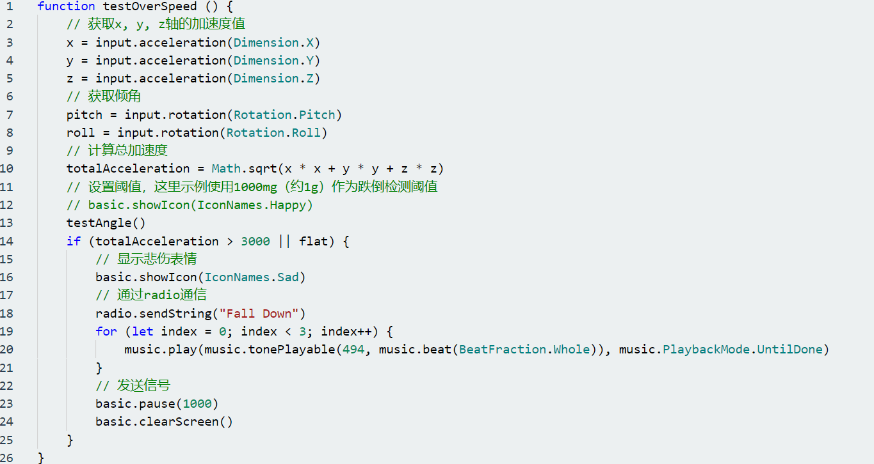
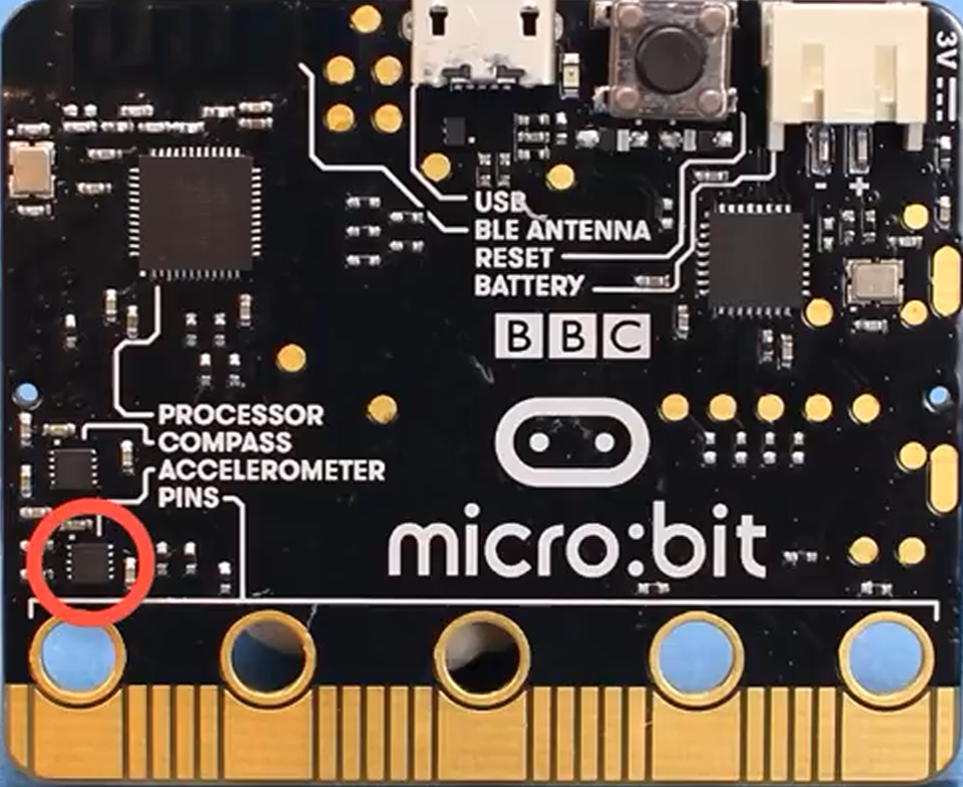
FALL Detection
With micro:bit built-in accelerometer based on MEMS technology
(micro-Electro-Mechanical System), the acceleration and inclination of the cane are monitored to detect the state of the fall.
Notes:
Here's the fall detection feature. We use the acceleration and inclination sensors of the micro:bit to detect if the user falls down.

Slide 13
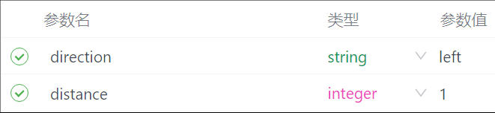
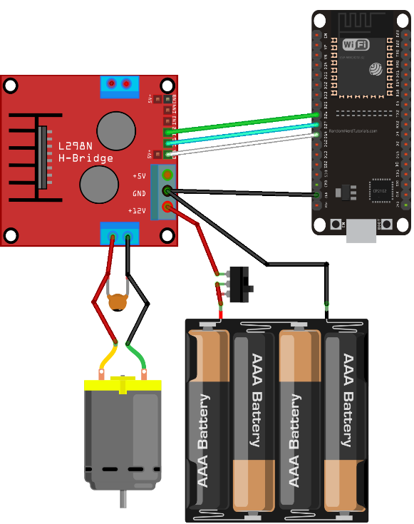
Automatic traction
The server executing navigation module send POST message to ESP32 server, driving the motors to run correctly.
Funny Thing: long-term blocking on a single core will cause the WDT(watchdog timer) reset, and the system will reboot! Since ESP32 is a dual-core system, we use multithreading in the FreeRTOS :)
Notes:
This is the motor driver server for automatic traction in the ESP32. It is worth noting that the ESP32 has a dual-core processor, allowing us to use the TaskPinnedToCore module to implement multithreading.

Slide 14
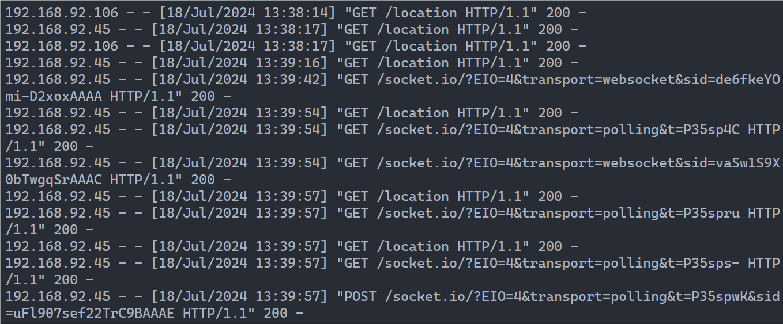
Fog Processor
A flask based data transition http server.
01
02
Location, video monitor, weather prediction, obstacle avoidance, alert, message...
Using http and websocket to communicate with frontend page.
Notes:
We have a Flask-based data server in the Raspberry Pi. It provides all data collected from sensors to the cloud server.

Slide 15
Details on machine learning models
04
Notes:
To better implement these features, we have used and trained many machine learning models.

Slide 16
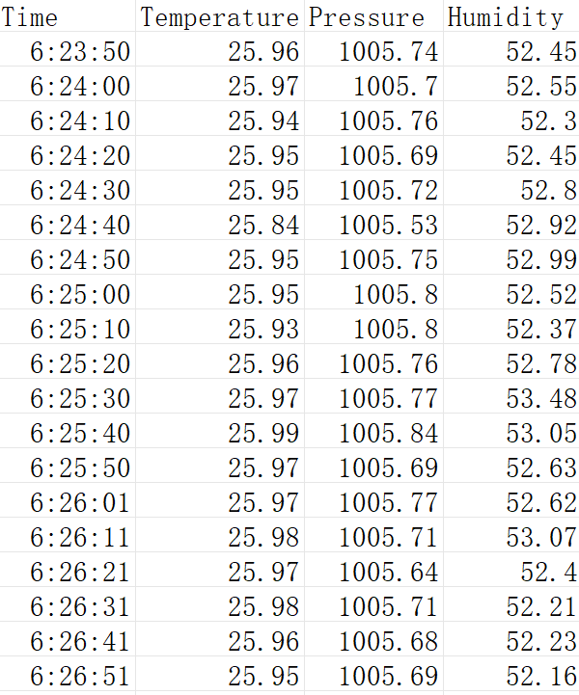
Linear Regression
Reasons for choosing
It is necessary to predict the weather after 20 minutes, and the weather changes linearly in a short period of time.
Data
The sensor collects temperature, humidity, and barometric pressure data every 10 seconds and stores it
Output
Outputs the predicted weather every minute to alert the user when the predicted weather is different from the current weather。
Notes:
The first is for predicting the weather after 20 minutes using linear regression to predict temperature, pressure, and humidity.

Slide 17
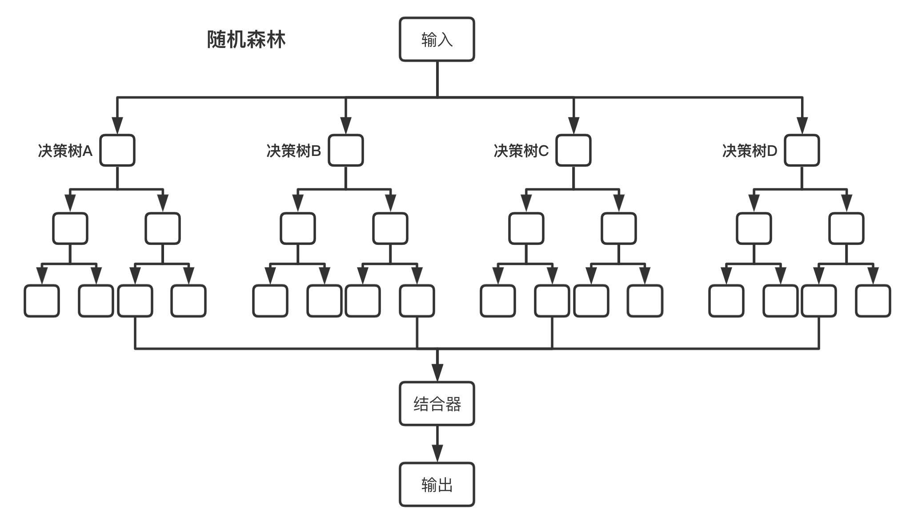
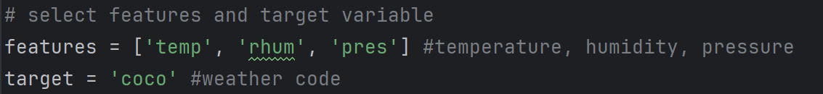
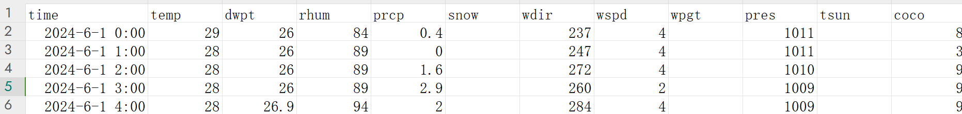
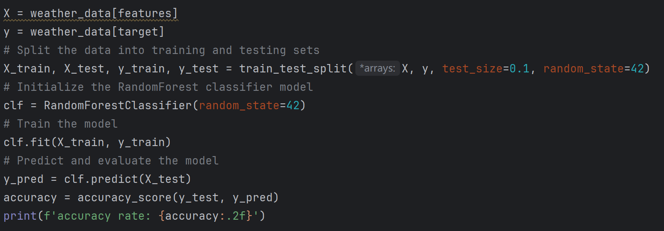
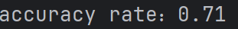
Random Forest Classifier
Dataset
Input
Decision Tree A
Decision Tree B
Decision Tree C
Decision Tree D
Aggregators
Training model
Output
Model accuracy
Notes:
Then, we trained a random forest classifier model to classify these data into specific weather conditions, such as cloudy or rainy. The model accuracy is shown here. If the weather changes, we will alert the user.
For future improvement of the prediction accuracy, we may first, add sensors and the features they measure to improve the prediction accuracy and reliability of the model. Second, combine random forests with other models to form more powerful ensemble models, such as Gradient Boosting or Extreme Gradient Boosting (XGBoost), to improve prediction performance

Slide 18


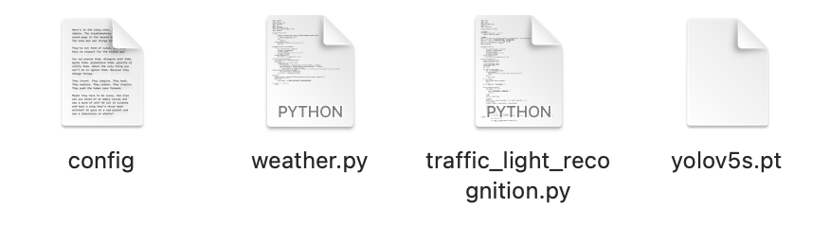


machine learning models
CV Based on Yolo v5
01
03
02
Traffic lights detection
Zebra crossing detection
Model Training
(Data scraped from the web)
Notes:
For the computer vision part, like traffic lights detection and zebra crossing detection, we use YOLO v5, and trained the model with data scraped from the web.

Slide 19
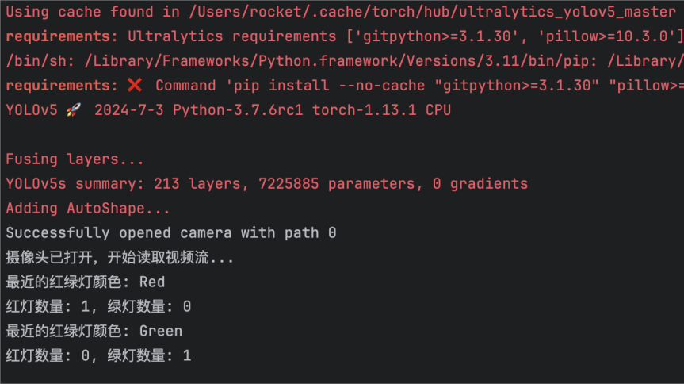
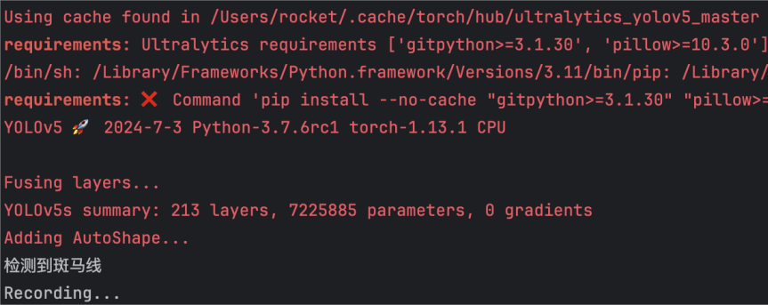
Recognition Results
Notes:
Here are examples of recognition results.

Slide 20
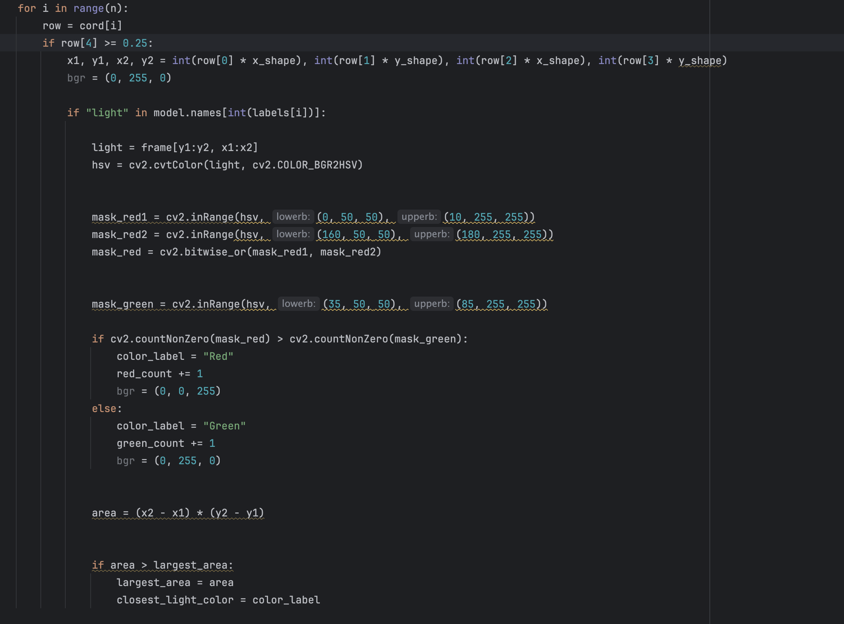
Traffic Lights Detection
Yolo v5
Color Detection
Notes:
For traffic light detection, we use a color detection algorithm.

Slide 21
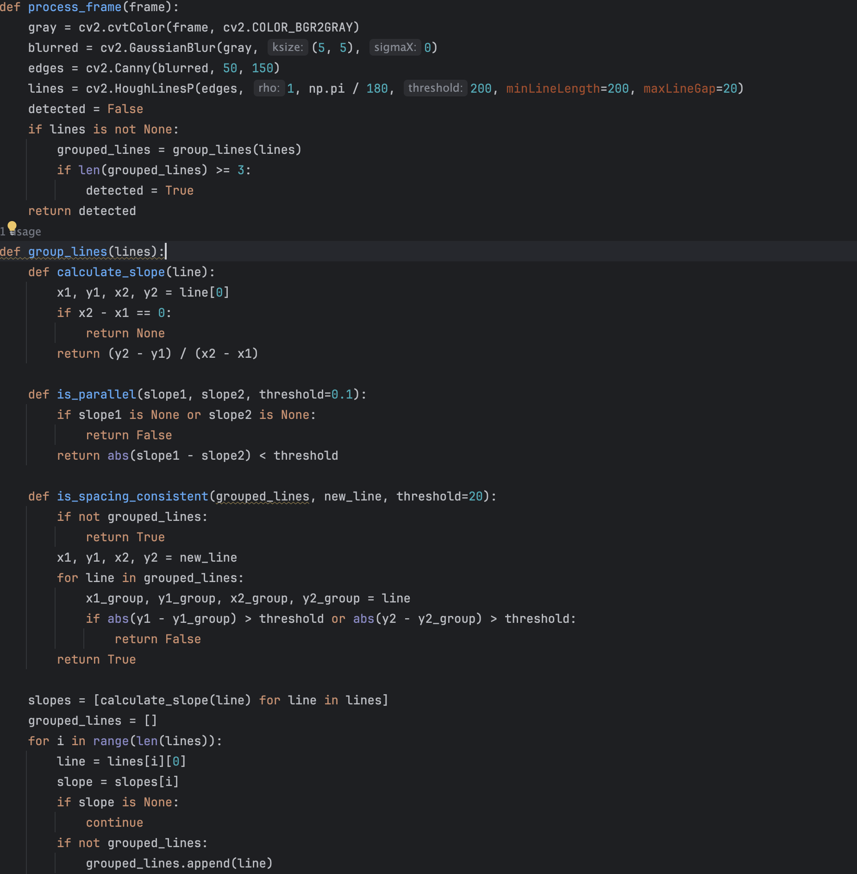
zebra crossing detection
Yolo v5
Hough Transform
Notes:
For zebra crossing detection, we use the Hough Transform algorithm to detect the necessary parallel lines and other shapes.

Slide 22
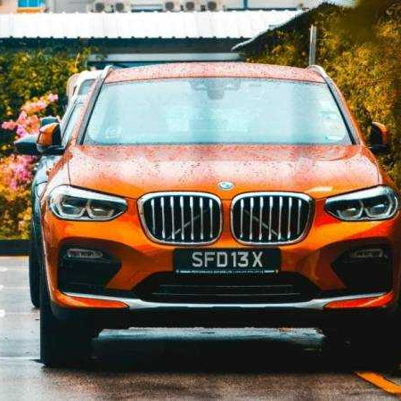
plate number detection
Yolo v5 + NMS
To remove duplicate test results, YOLO uses Non-Maximum Suppression (NMS) to retain the highest scoring bounding boxes.
Notes:
And for plate number detection used in car reservation, we use NMS to retain the highest scoring bounding boxes.

Slide 23
Details on software applications
05
Notes:
We have a solid architecture, but we also need excellent software applications.

Slide 24
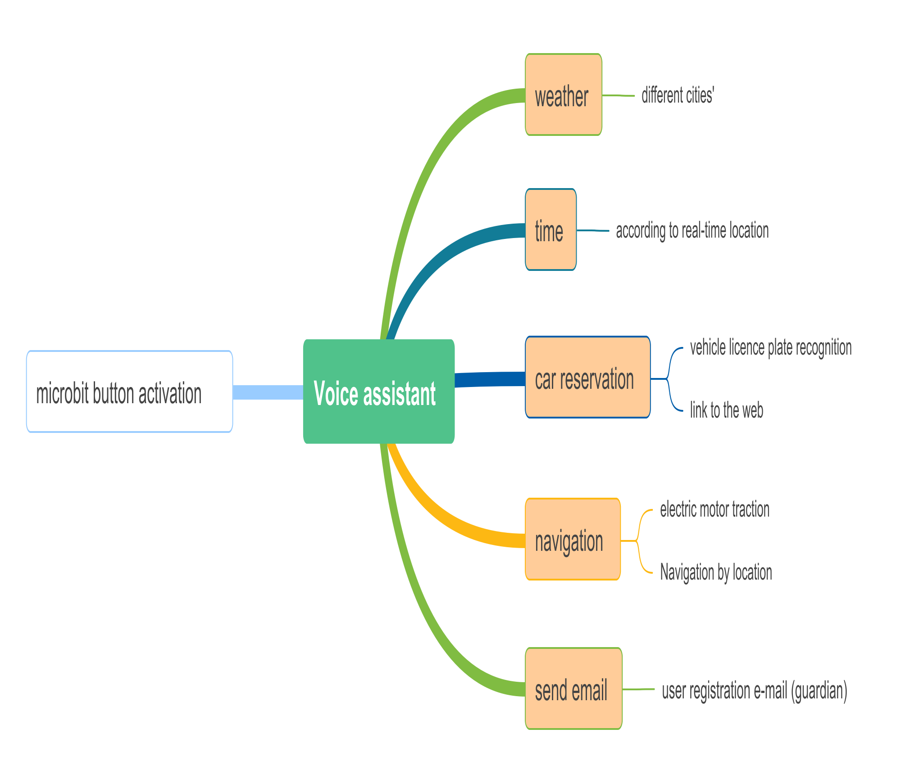
Notes:
Considering the actual conditions of visually impaired individuals, we have reduced the number of physical buttons and used an intelligent voice assistant to help users perform most operations, like querying weather and time, car reservation, navigation, and email communication with the user's family member.

Slide 25
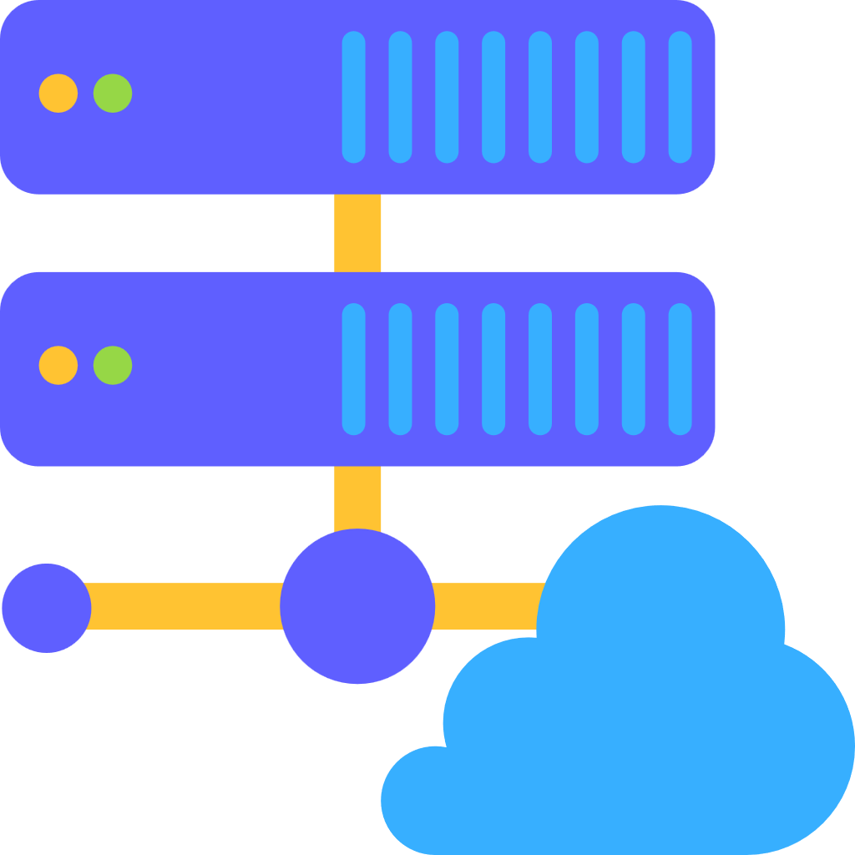


01
User management system and data server based on SQLite.
Cloud Server
02
React based Webpage.
Notes:
Here is the software structure on the cloud server. The backend is a user management system and data server, and the frontend is a React-based webpage.

Slide 26
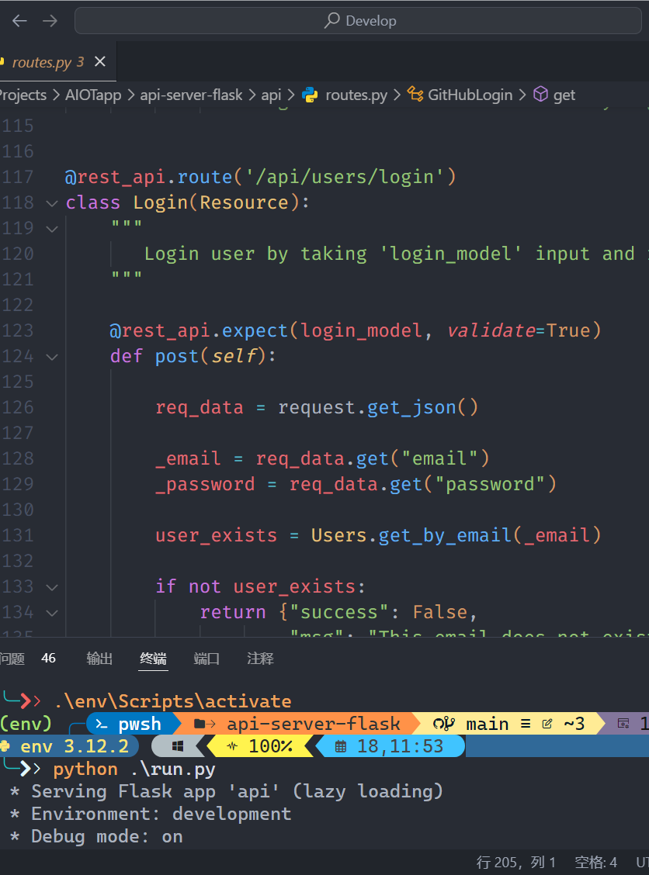
Backend Server
A flask based user management http server.
An user authentication system based on JSON Web Token (JWT).
An user database storage management system based on SQLite.
Notes:
The backend is a Flask-based user management server, and we use JWT for authentication and SQLite for user database storage.

Slide 27
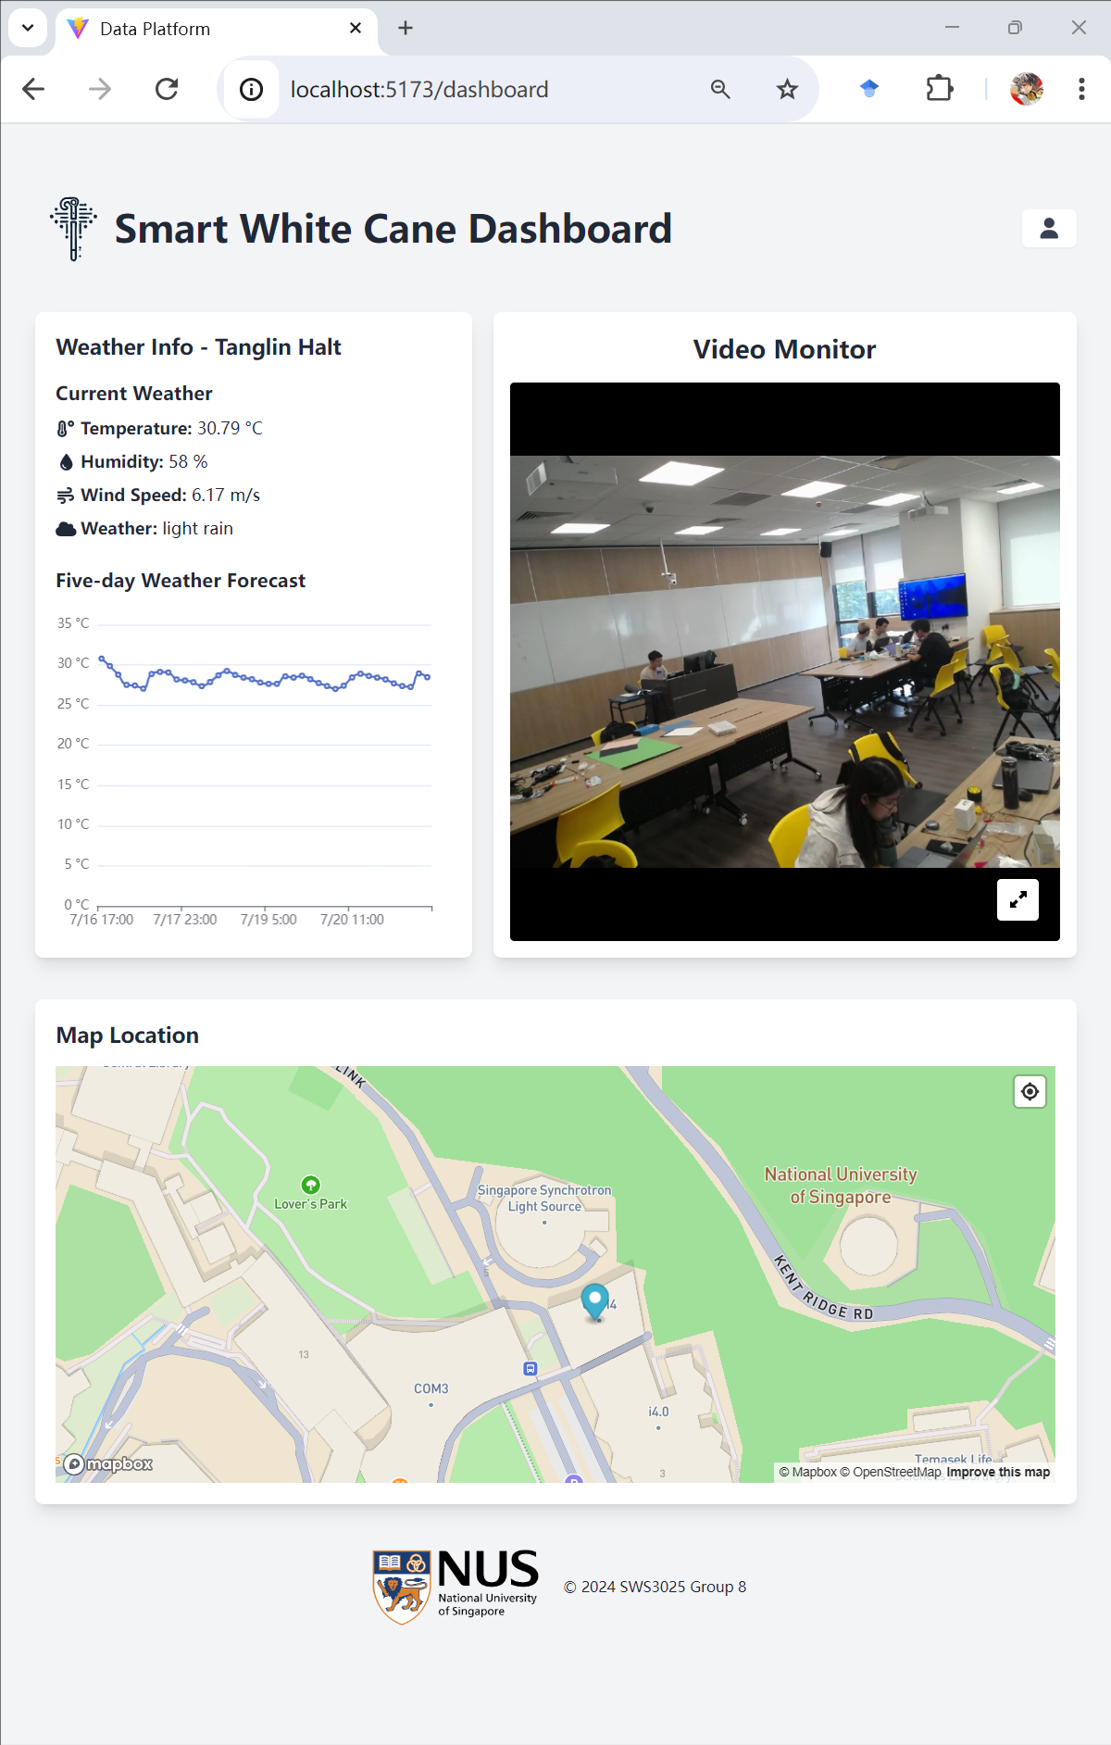
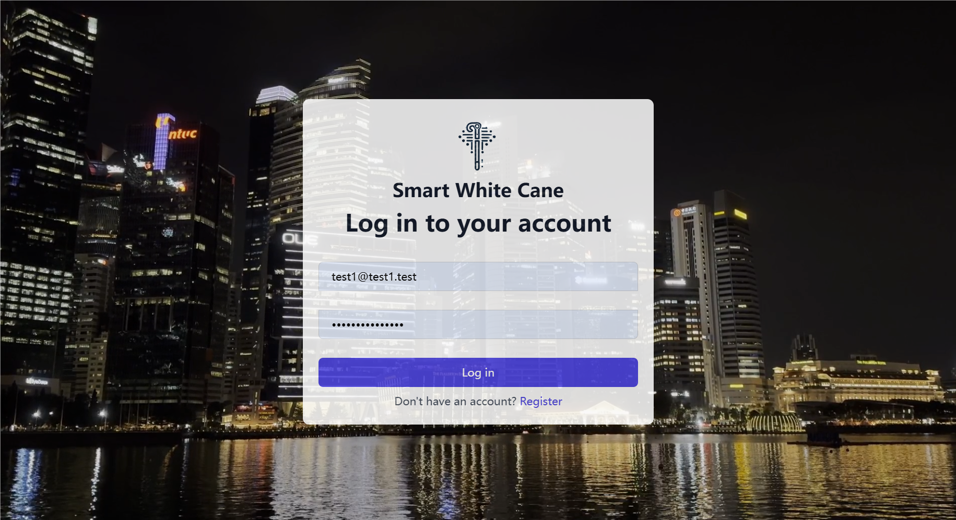
Webpage
A React based frontend webpage.
Vite, React, TypeScript, TailwindCSS, DaisyUI, ECharts...
Notes:
The frontend is a React-based webpage, and we also use cutting-edge web development technologies like Vite, React, TypeScript, and TailwindCSS, etc.

Slide 28
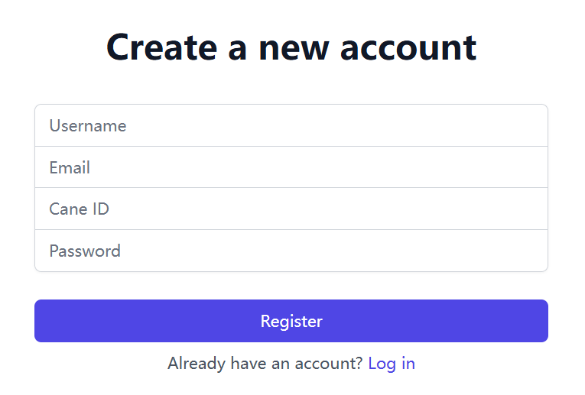
Webpage
Login page and register page.
Every account is binding to an only cane by ID.
Notes:
This is the login page, and we ensure every account is binding to an only one cane by ID.

Slide 29
Notes:
Here is the webpage's detail. Here is the current weather info and weather prediction. Here is a real-time video monitor sent from the cane.

Slide 30
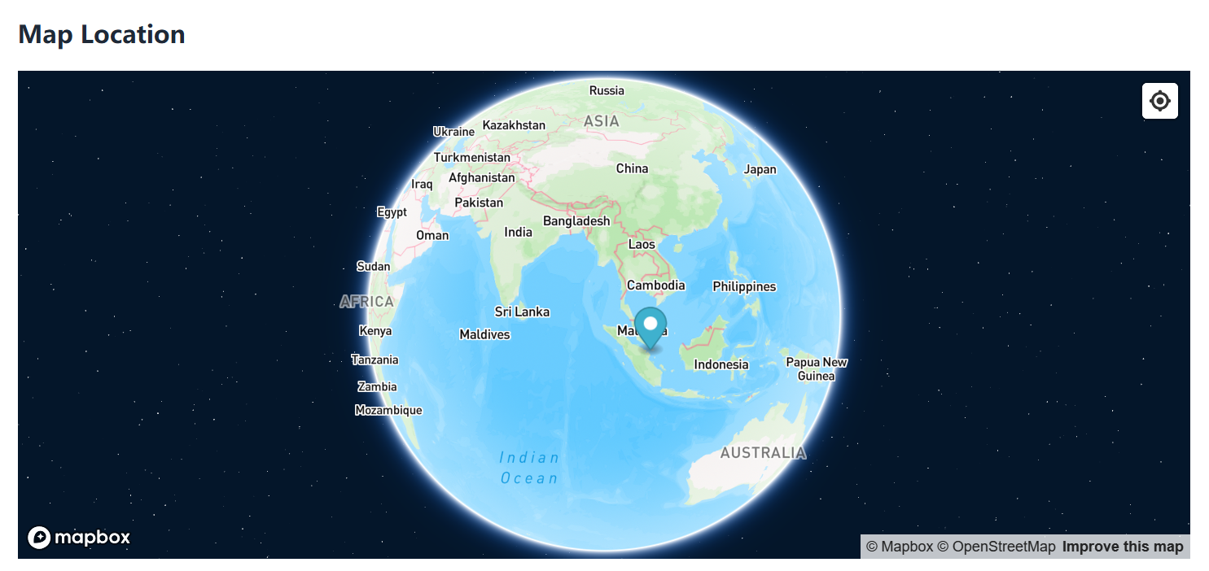
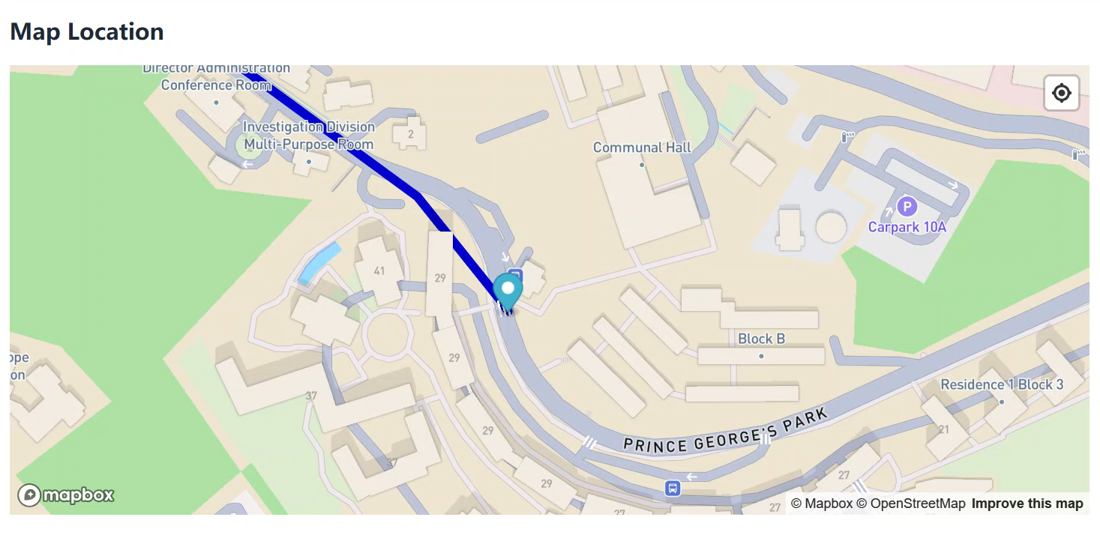
Notes:
Here is the real-time location of the cane, also of the user. And we provide global location and real-time route line once the user is moving.

Slide 31
THANK YOU
AIoT Group8
Notes:
That's all for our intelligent white cane's design. Thank you.

